Slide 1
Common Course:
Workplace Skills
Unit 1.06

Slide 2
Purpose of this Section
Students will be expected to:
  1.06 relate the role of organized unions to the skilled tradesperson. [4.403] [5.402]

Slide 3
Labour Unions
What is the rationale for the existence of labour unions in the workplace.
Historical impact that unions had on labour wages, rights, and benefits.
Relate the role of unions to ensuring a safe and hazard free work site for the skilled tradesperson.
Emphasize the need for participation in, and knowledge of, the respective trade unions.
The various worker protection associations such as:
  Workers compensation
  Employment insurance
  Occupational health and safety

Slide 4
History
1873 – The Canadian Labour Union: The birth of Canadian organized labour
Until quite late in the 19th century, Canadian workers were often obliged to contend with horrendous conditions—long hours, few holidays and minimal rights in the marketplace.

Slide 5
History
In an era when the ‘captains of industry’ ruled the economy, quitting a job could be construed as a criminal offence for a worker, punishable by imprisonment under the Master and Servant Act.

Slide 6
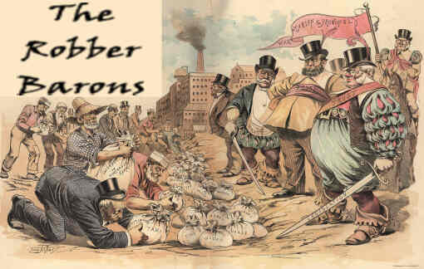
Captains of Industry

Slide 7
History
Workers' ability to form unions and take collective action was severely constrained by the law--unions were seen as unlawful associations. Although local unions existed, it was illegal to form unions up until mid-1872.

Slide 8
Change
Prime Minister John A. Macdonald introduced a bill in Parliament to make trade unions legal—Parliament passed the Trade Unions Act on June 14, 1872. Macdonald declared that he was the “working man’s friend”.

Slide 9
CLU
Just a year later, in 1873, the Canadian Labour Union (CLU) was formed in Toronto at a convention of union members from Toronto, Hamilton and Ottawa.
The CLU platform called for shorter working hours, and vigorously opposed the use of convict labour and employment of children under the age of 10 years.
Such labour activism tended to attract skilled, relatively well-paid workers; the vast majority of unskilled workers in the economy remained powerless in the market place.

Slide 10
CLU
The union not only advocated for the benefit of the working classes but also became involved in political activities. In subsequent conventions, the CLU passed resolutions calling for all men to have free public education, direct labour representation in Parliament, and the right to vote.

Slide 11
CLU
Although the CLU did not survive long, it did realize several legislative successes: a new Mechanics' Lien Act made it easier for employees to recover wages owed to them; peaceful picketing was given some shield from criminal prosecution; and some of the harsher provisions of the Master and Servant Act were eased.

Slide 12
Canadian Labour Congress
By the 1880s, the economy was recovering and so was union membership: the 54 local unions in Canada in 1880 grew to 240 by 1890. In 1883, a fresh initiative was taken to form a national union, the Labour Congress of Canada, which later became the Trade and Labour Congress of Canada (TLC).
The TLC was one of the forerunners of the present Canadian Labour Congress -- now a major national labour organization in Canada.

Slide 13

Your Turn
Do you know anybody in a union?

